Slide 1

Predicting Hotel Cancellations
Valerie Zixi Li
Sociology Ph.D. Student, Affiliated with Population Studies and Training Center
https://github.com/ZixiLi76/Hotel-Cancellation-Prediction
Oct 25 2024

Slide 2
Question & Data
Question: What factors affect hotel cancellations?
Optimize revenue management, enhance customer experience, improve operational efficiency
Hotel booking demand dataset from Kaggle: https://www.kaggle.com/datasets/jessemostipak/hotel-booking-demand/data
The dataset: booking & cancellation details for city and resort hotels, featuring variables like booking dates, length of stay, guest count, # of special requests, …, with all personal information removed
Collection methodology: data was sourced from ScienceDirect and cleaned by Thomas Mock and Antoine Bichat for #TidyTuesday, available on GitHub.
Target variable (y): is_canceled (dichotomous) – classification problem

Slide 3
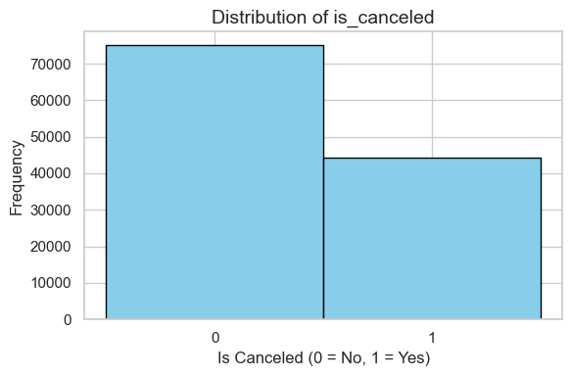
EDA – Cancellations & Hotel Type

Slide 4
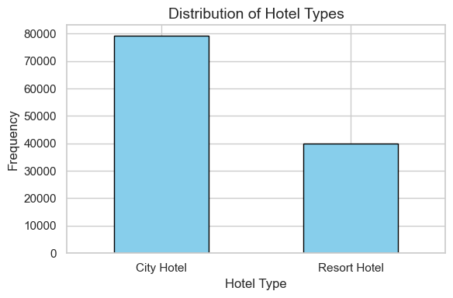
EDA – Cancellations & Hotel Type

Slide 5
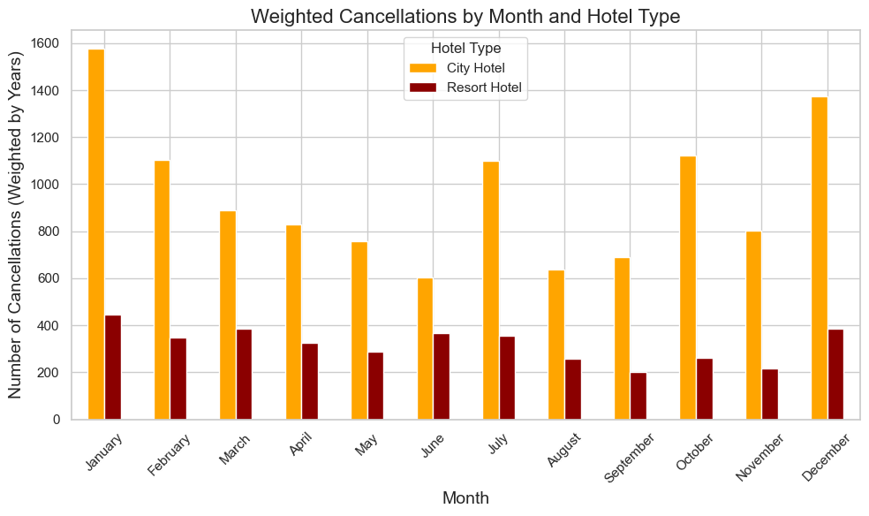
EDA – Cancellations & Hotel Type

Slide 6
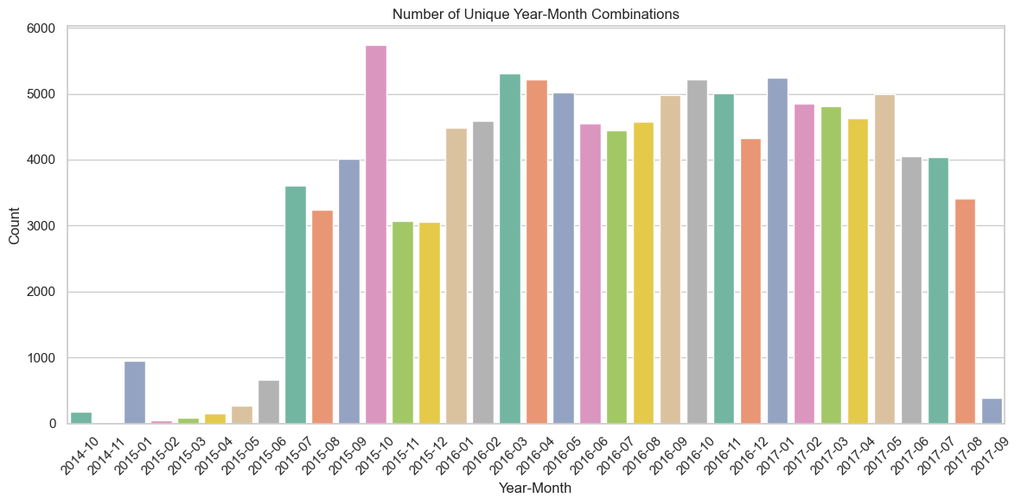
EDA – Unique Year-Month Combinations

Slide 7
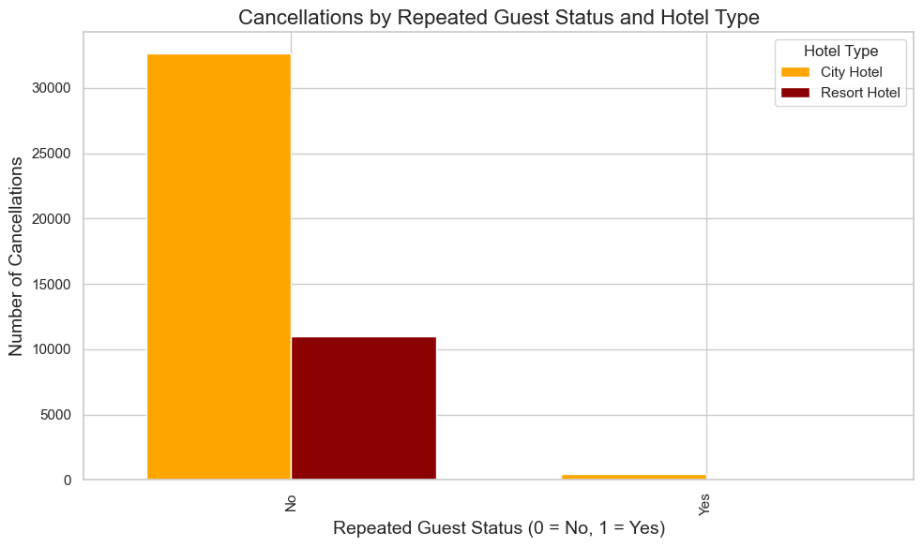
EDA – Cancellations by …

Slide 8
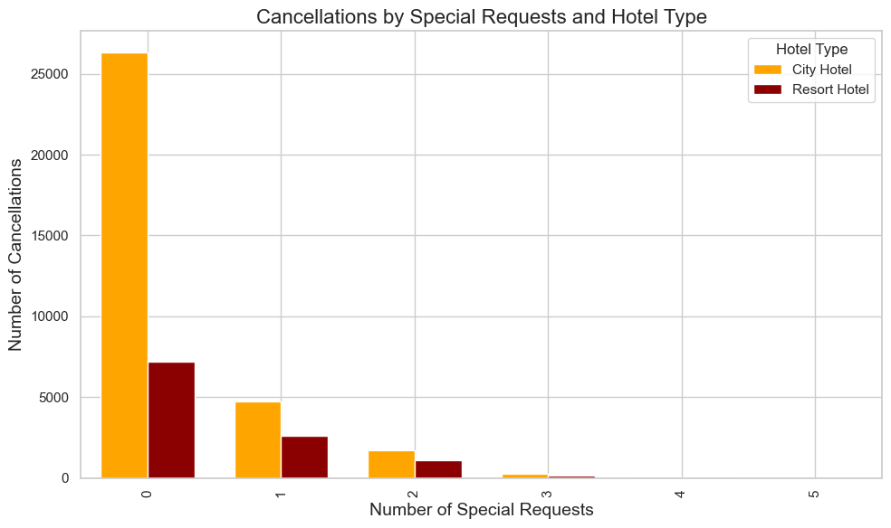
EDA – Cancellations by …

Slide 9
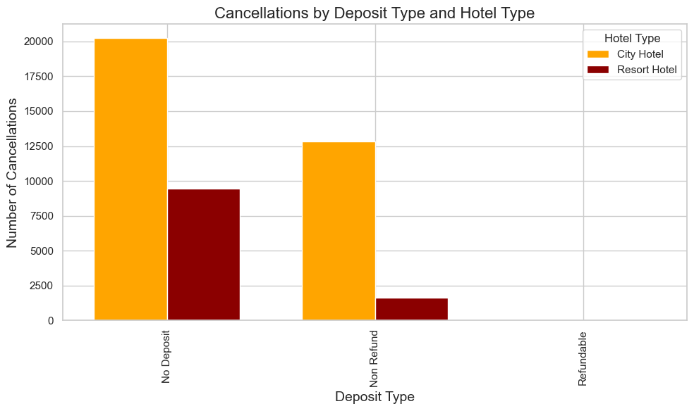
EDA – Cancellations by …

Slide 10
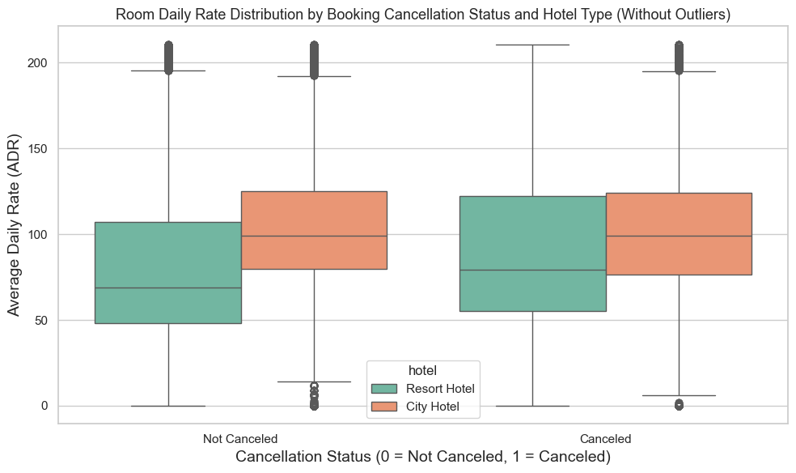
EDA – Cancellations by …

Slide 11
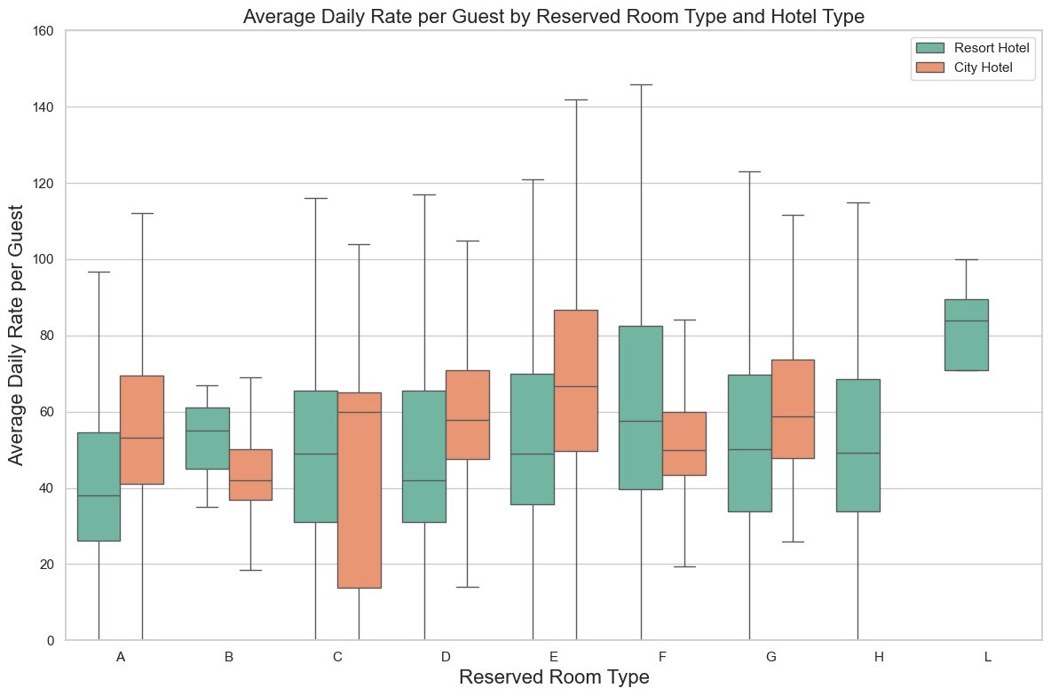
EDA – Descriptives

Slide 12
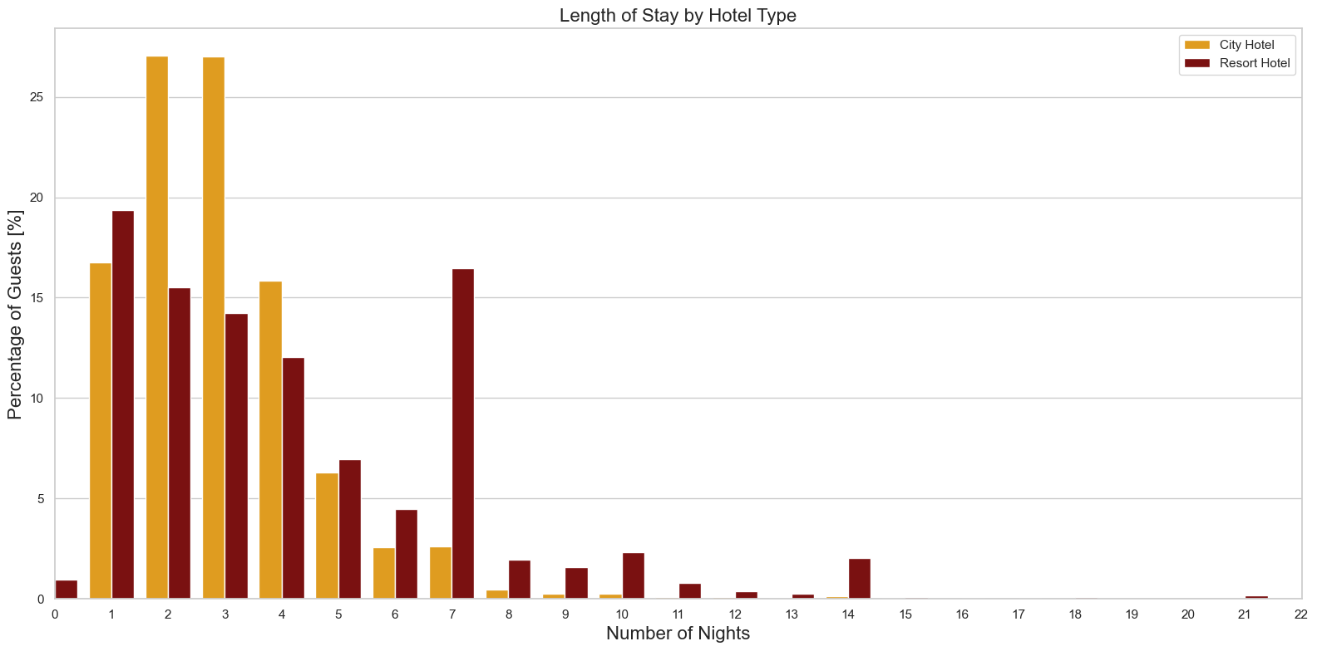
EDA – Descriptives

Slide 13
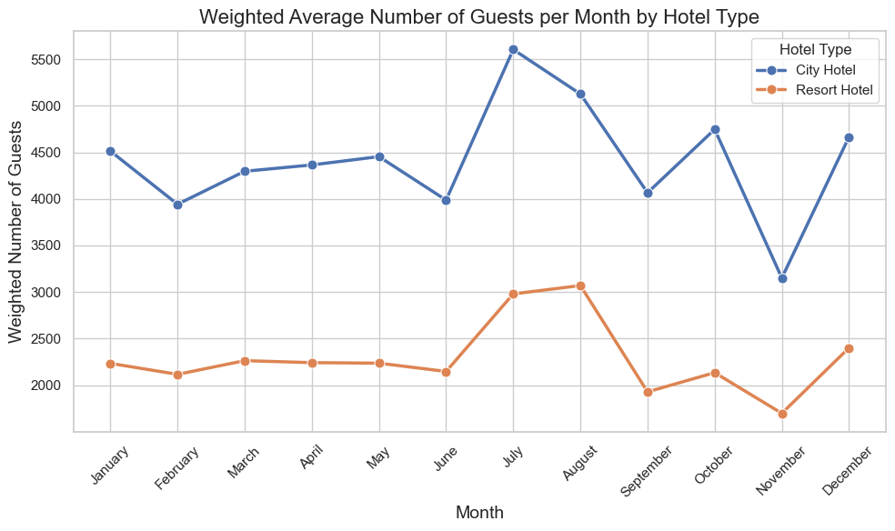
EDA – Descriptives

Slide 14
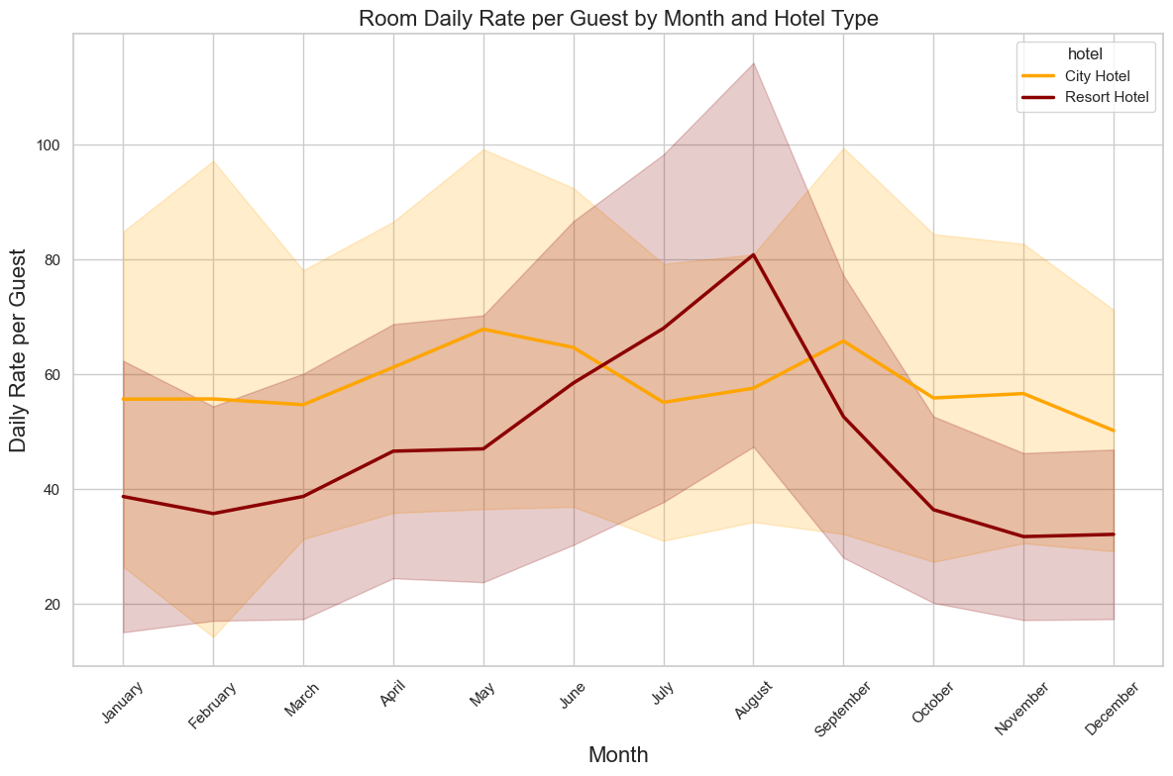
EDA – Descriptives

Slide 15
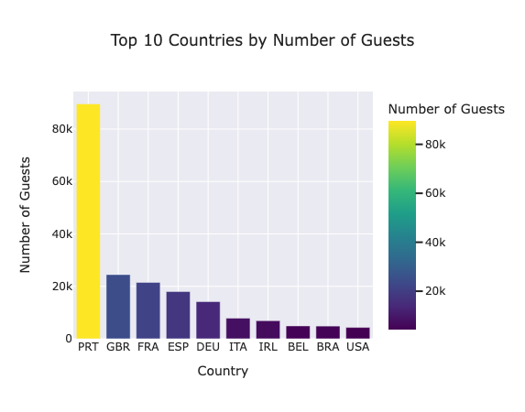
EDA – Descriptives

Slide 16
Preprocessing
Splitting strategy: data split into 60% training, validation (20%) and test (20%); random state set to ensure reproducibility
Preprocessors:
Categorical features: missing values in 'country’ (41%) imputed with 'Unknown' using SimpleImputer; one-hot encoding applied to categorical features
Numerical features: standardized using StandardScaler to ensure features are on the same scale
Features & data points: original training set shape – (71523, 29) – 10 categorical 19 numerical; preprocessed training set shape – (71523, 240)
Missing values
Country: 41%, imputed & one-hot encoded
Children: 0.3%, number of children, dropped (only 4 rows)
Company: 94.3%, ID of booking company, dropped this column because no need for ID
Agent: 13.7%, ID of travel agency, dropped this column because no need for ID

Slide 17
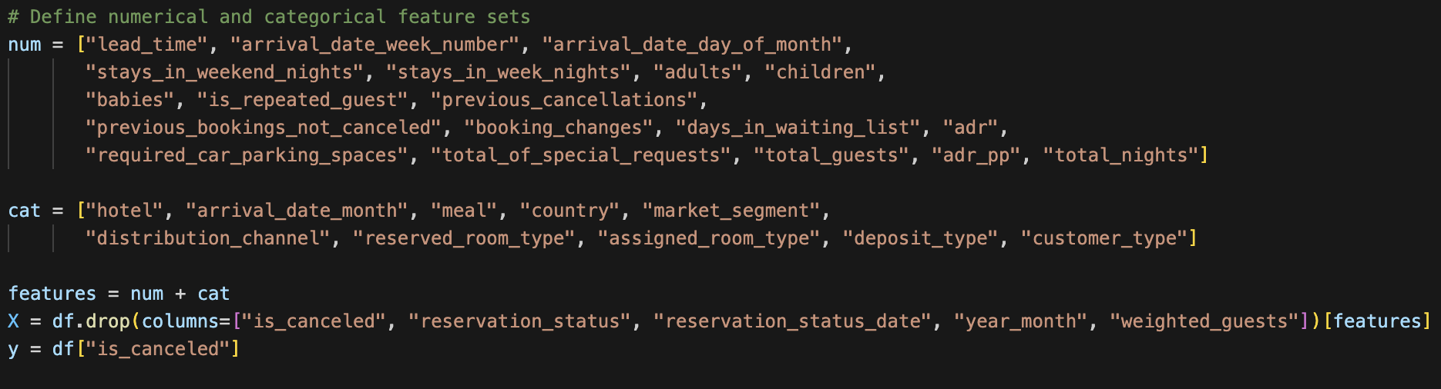

Slide 18
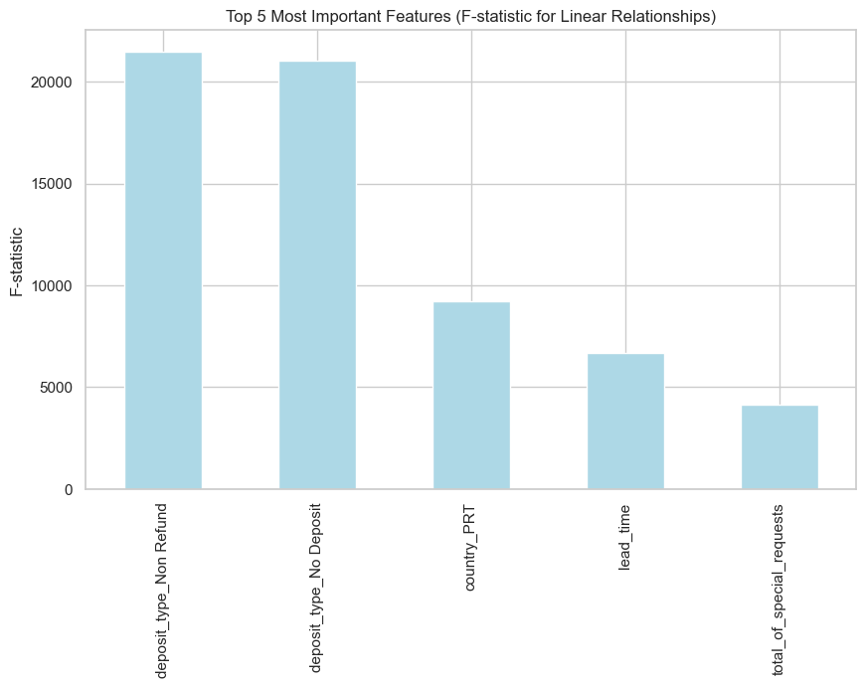
Top 5 Features

Slide 19
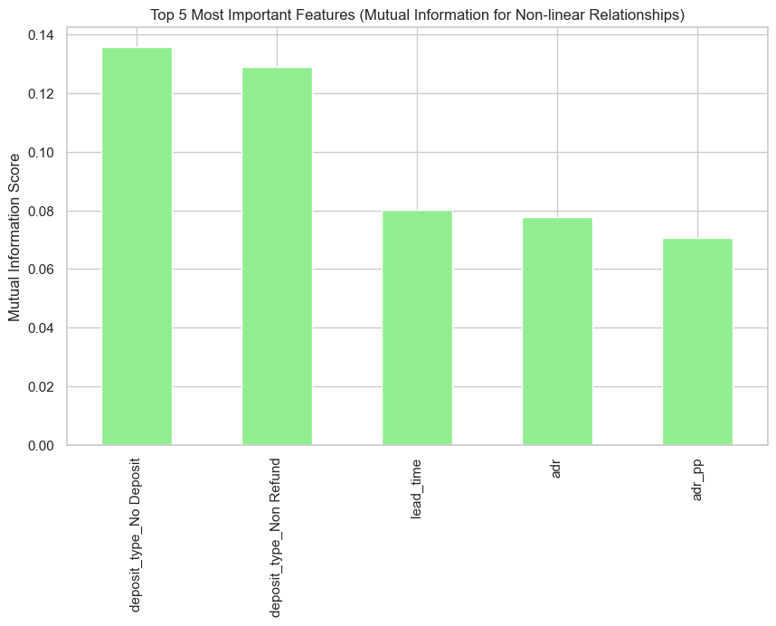
Top 5 Features

